Slide 1
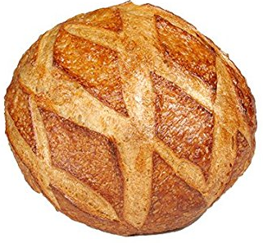
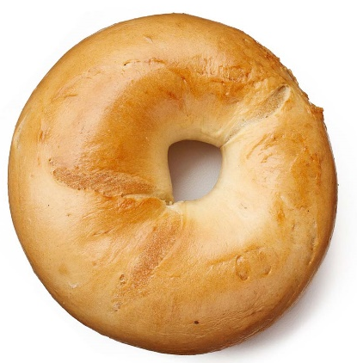
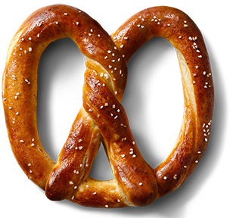



$$g=0$$
$$g=1$$
$$g=3$$

Slide 2
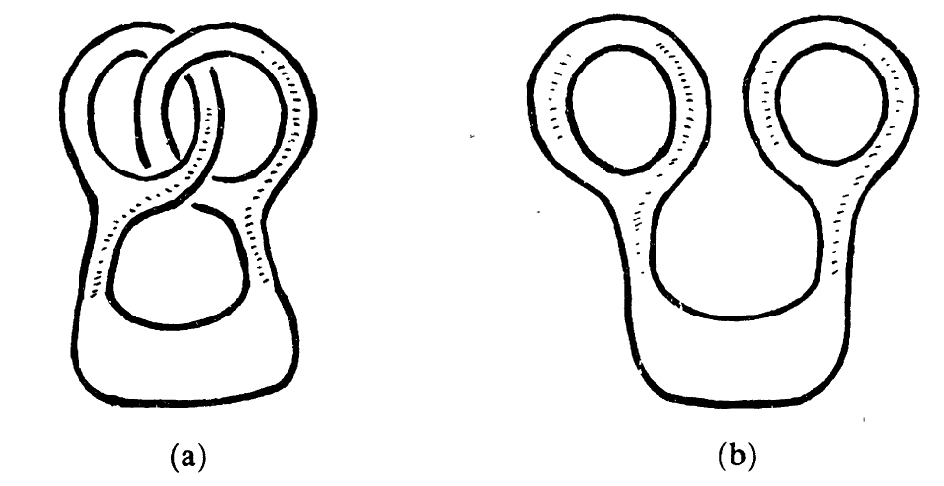

Slide 3


$$B$$
+
+
+
-
+
-
+
-
+
-
-
-
$$E$$

Slide 4
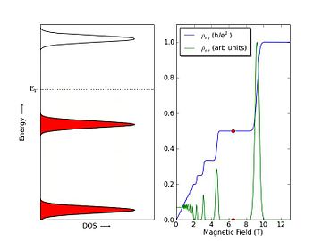

Slide 7
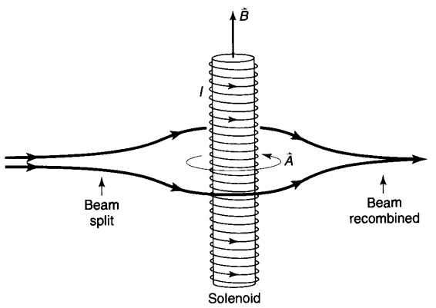
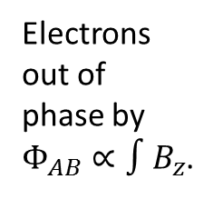
In phase electrons
Electrons out of phase by $Φ_{AB}∝∫B_{z}$.

